Slide 1

UWEBIC IY425
Electrical and Electronic Engineering Principles 2
Serial-Parallel-Circuits: Quiz
Mohammad Hosseinabady
Wednesday 19-Jan-2022
mohammad.hosseinabady@kaplan.com

Slide 2
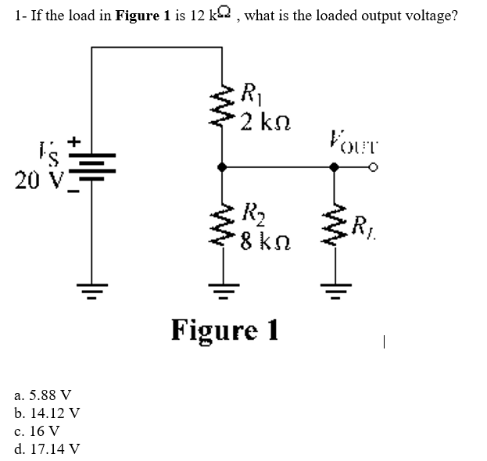
Answer: b

Slide 3

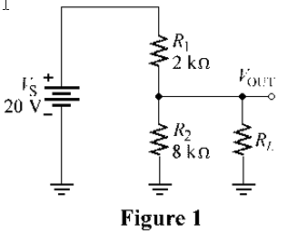
Answer: b

Slide 4
a. 0 V b. 4 V c. 16 V d. 20 V
Answer: c

Slide 5
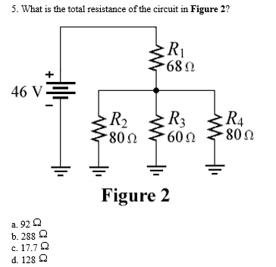
Answer: a

Slide 6
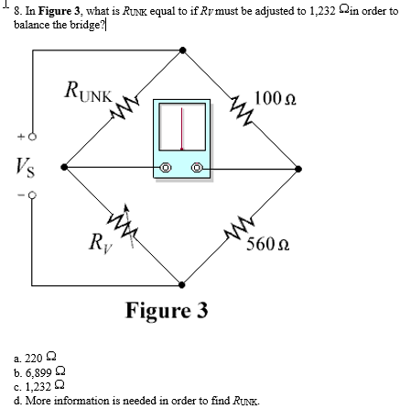
Answer: a

Slide 7
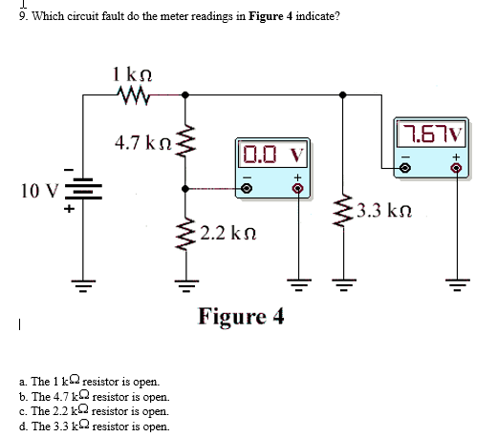
Answer: b

Slide 8
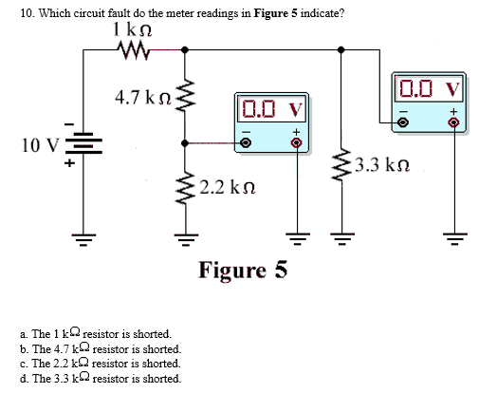
Answer: d

Slide 9
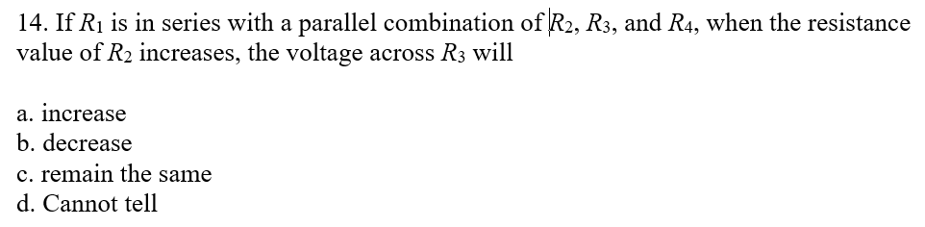
Answer: a

